Slide 1


Loan Default Prediction
Date: 12/05/2022
Presented by: Chea Bunlong

Slide 2
Table of Contents
01
02
Problem Statement
Introduction of Lending Club
03
The Process of Analysis
04
The Results of Finding

Slide 3

01
Introduction of Lending Clubs

Slide 4
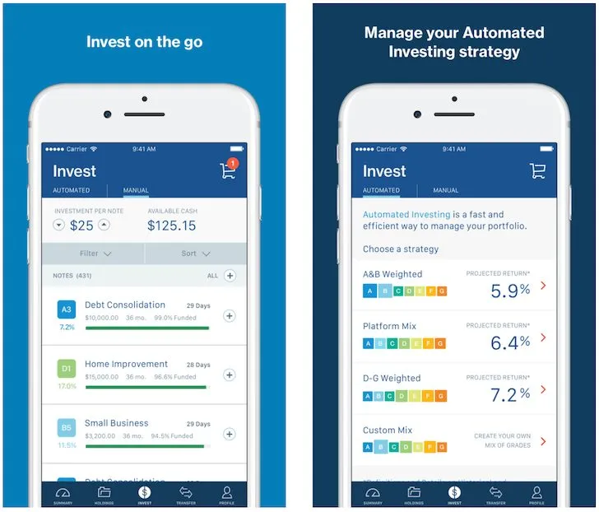
Lending Club is a P2P online service of lending money between investors and borrowers or businesses
Investor can earn risk-adjusted return, to help them determining whether the risk taken was worth the expected reward.
Investor can assess risk and review loan application of borrower provided by Lending Club (LC)
Investor receive offer in just a minute with no impact credit score.
Investor can earn monthly returns.

Slide 5
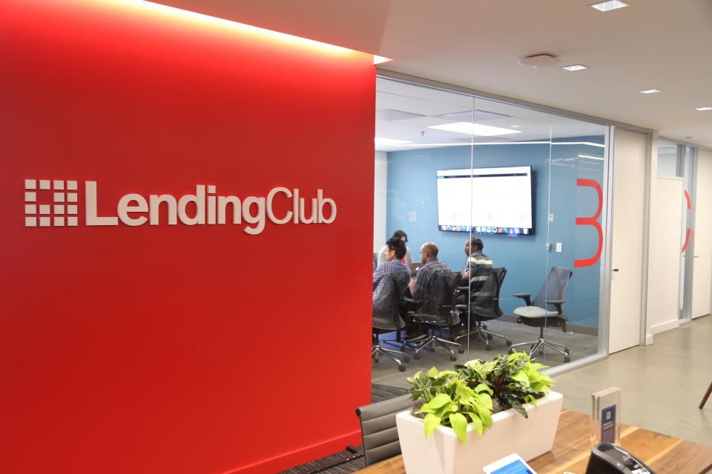
02
Problem Statement

Slide 6
According to this setting, investors can easily make wrong decision to give loan.
DataU
The borrowers receive the loan even if they don’t have ability to return the money.
The borrowers or businesses might go bankruptcy without any payment.
The borrowers have government tax-debt or other debt
To avoid these risk, LC conduct a set of exploratory analysis to identify the risky loan applicants at the time of loan application so that such loans can be reduced thereby cutting down the amount of credit loss,

Slide 7
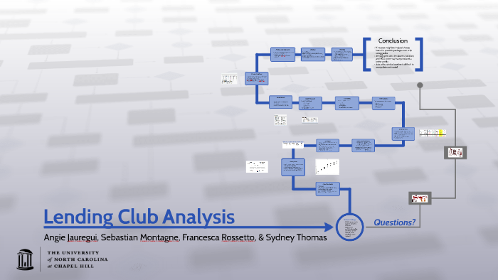
03
The Process of Analysis

Slide 8
First Step
DataU
Load Data
Exploratory Data Analysis
Clean Data
Load data called “accepted” that include both Fully Paid & Charged Off
Get to know about the data and do research
Reduce columns that missing, modify data types, remove outliers,

Slide 9
Second Step
DataU
Feature Selection
Train Test Split
Model and Roc Curve
Check and process data over again to increase accuracy, precision,& recall
Split the data into train and test set to model and evaluate the correction
Train to find the best model and implement testing to get correction

Slide 10
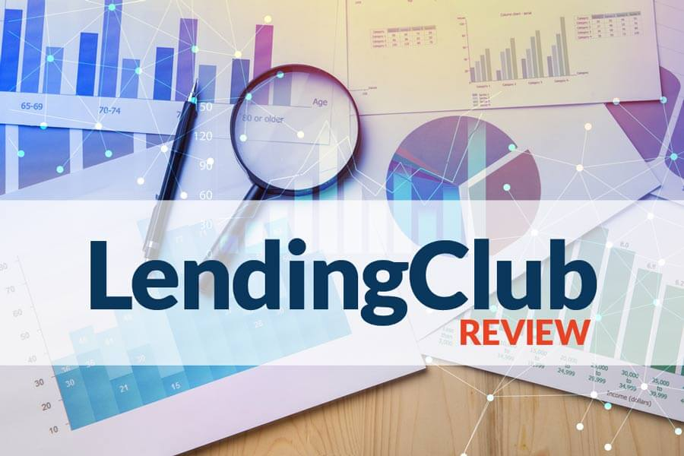
04
The Result of Finding

